Slide 1
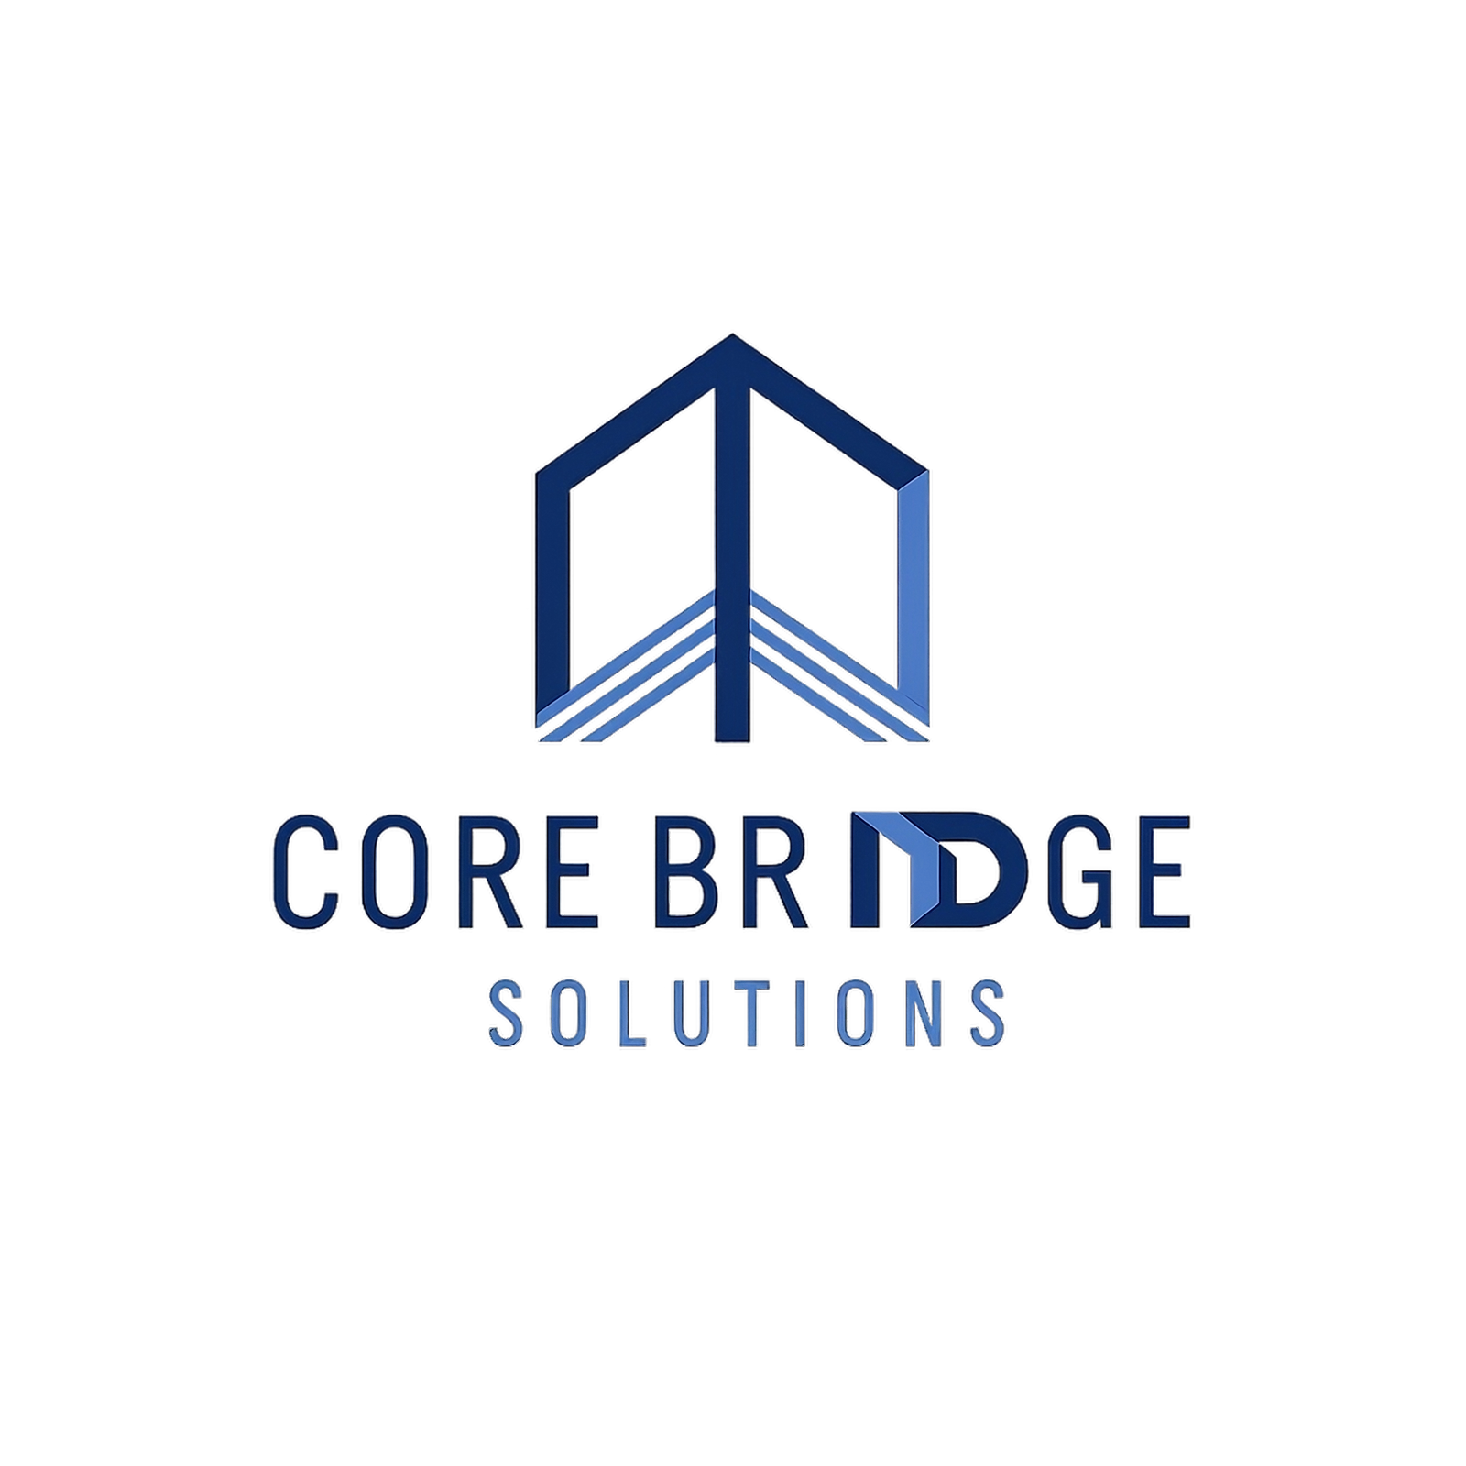
Corebridge Solutions
For All Your Business Needs

Slide 2

About Corebridge Solutions
  At Corebridge Solutions, we specialize in providing end-to-end digital and back-office solutions.
  Our Mission: Deliver high-quality, scalable, and cost-effective solutions.
  Our Vision: Become a trusted global partner for outsourcing, digital transformation, and creative services.

Slide 3

Our Mission
Innovation
We strive to develop cutting-edge solutions for our clients.
Reliability
Our commitment ensures that clients can trust us always.
Excellence
We pursue the highest standards in everything we do.

Slide 4

Core Services
Delivering Innovative Solutions for Your Business Needs
  BPO & Back Office Solutions
  Content Solutions
  Creative & Design
  Digital Marketing
  AI-Powered Solutions

Slide 5

BPO & Back Office Solutions
  Data Entry & Management
  Back-Office Operations
  Customer Support Services

Slide 6

AI-Powered Solutions
  Basic Generative AI Support
  Data Annotation
  Model Training Assistance

Slide 7

Content Solutions
  Content Curation & Strategy
  Content Writing & Editing
  Copywriting
  Social Media Content

Slide 8

Digital Marketing
  Social Media Marketing
  SEO & Website Optimization
  Paid Campaigns (Google, Meta Ads)
  Marketing Strategy & Consulting

Slide 9

Creative & Design
  Graphic Design (branding, social media, marketing assets)
  3D Product Design & Visualization

Slide 10

Our Values
Corebridge Solutions' commitment to our key principles and culture
  Integrity in all actions
  Collaboration across teams
  Customer focus at the forefront
  Continuous improvement for growth

Slide 11

Corebridge Advantage
Unique Expertise and Tailored Solutions for Our Clients’ Success
  Results-Driven Approach
  Innovative Strategies
  Comprehensive Custom Solutions
  Experienced Professionals

Slide 12


Contact Us
We look forward to connecting with you soon!
Email
info@corebridgesolutions.in
Phone Number
(+91) 8910587320
Website
www.corebridgesolutions.in
PORTFOLIO

